Slide 1


Hotel & Restaurant
Management
Project By : Government Polytechnic Gandhinagar

Slide 2


Group : 1
Sonani Jemish :- 206230307012
Vaghasiya Dhrudeep :- 206230307008
Shah Manthan :- 206230307019
Gadhiya Yash :- 206230307007
Project Guide :
Head of Department :
Prof. Meeta Prajapati
Prof. M. J. Desai

Slide 3
Abstract
Hotel & Restaurant Management is Web-Development based application that allows the Hotel & Restaurant to handle all activities online. Interactive GUI and the ability to manage various Hotel & Restaurant booking make this system very flexible and convenient. We have tried our best to make the complicated process of Hotel & Restaurant Management System as simple as possible using user friendly GUI and menu-oriented interface and simple database programming. Our project is designed like that users do not have to try like other web applications. The system provides information regarding the different Hotels that are available and their status specific to availability. The project is made in such a way that the user does not have to consume more time on hotel room booking and restaurant table booking, it means all progress is computerized.
Hotel & Restaurant management project also provide staff management and other necessary services. Customers can check available rooms & restaurant tables and book online. Admin has the power to either approve or disapprove the customer’s booking request. The users can use the system to advertise available rooms.

Slide 4
Topic to be covered
Project Process
Project Purpose
Project Scope
Hardware & Software Requirement
Requirement Analysis
Technology
Diagrams
Database
Implementation & Planning
Conclusion

Slide 5
Project Purpose
The purpose of the hotel & restaurant booking system is to automate the existing manual system with the help of computerized equipment so that their valuable information can be stored for a longer period with easy accessing and manipulation of the same.
This System is beneficial to all business people because if they do not have sufficient time to book that time they can use an online Hotel & Restaurant.
Hotel and restaurant management web application allows people to book rooms in hotels and book tables in restaurants easily from one place.

Slide 6
Project Scope
Searching of Hotels & Restaurant Will be Easier. We will provide hotel & restaurant details and contact number.
We will provide hotels Details & food reviews etc.
We will provide feedback section in that user can give feedback about that hotels & Restaurant.

Slide 7
Hardware & Software Requirement
Hardware Requirement
RAM - 2 GB
Hard Disk Space – 1 GB free
Processor: Intel Platinum Quad core or more
Internet: Required
Screen-resolution: 1280×1024
Software Requirement
OS: windows 7 or more
Frontend: HTML, CSS, JAVA Script
Backend: MySQL, NodeJS
Programming Tools: VS Code
Documentation Tools: Microsoft Word, Microsoft PowerPoint

Slide 8
Requirement Analysis : Users
Registration.
Login.
Email address.
Book Rooms and Hotel.
Check in and Check out time.
Payment.
Feedback.

Slide 9
Requirement Analysis : Admin
Registration.
Login.
Email address.
Add offers.
Add Hotels and Restaurant.
Changes some minimal functions.

Slide 10
Project Process : User
Registration.
Input : Full Name, Email id, Phone no, username, password
Output : Registration successful
Login.
Input : username, Password
Output : Login successful
Book Rooms and Hotel.
Input : Check room available or not, check best hotels and restaurants
Output : Booking Cart

Slide 11
Project Process : User
Check in and Check out time.
Input : How many people stay, How many day to stay, total no of room, check in and check out- time, extra bed
Output : Booking Successful
Payment.
Input : UPI id ,Bank details, Card details
Output : Payment Successful
Feedback.
Input : Your experience
Output : Thank you for good feed back, Please visit again.

Slide 12
Project Process : Admin
Login.
Input : username, Password.
Output : Login successful.
Edit Content.
Input : Add or Remove Hotels and Restaurants.
Output : Edit successful.
Manage Offers.
Input : Add / Remove Offers and Coupon.
Output : According Offers / Coupon price will change.

Slide 13
Project Process : Admin
Confirmation Booking.
Input : Accept / Decline Booking.
Output : Booking Accept / Decline.
Check Feedback.
Input : Check Feedback.
Output : According to feedback improve Website / Hotels & Restaurant Services.

Slide 14
Non Functional Requirement
Security.
Speed of web service.
Forgot Password.

Slide 15
Technology
HTML :
HTML stands for Hypertext Markup Language.
It is used to design web pages using a markup language. HTML is the combination of Hypertext and Markup language.
A markup language is used to define the text document within tag which defines the structure of web pages.
CSS :
CSS (Cascading Style Sheets) is the language for describing the presentation of Web pages, including colors, layout, and fonts.
It allows one to adapt the presentation to different types of devices, such as large screens, small screens, or printers.
JavaScript :
Our JavaScript Tutorial is designed for beginners and professionals both. JavaScript is used to create client-side dynamic pages.
JavaScript is an object-based scripting language which is lightweight and cross-platform.

Slide 16
Technology
MySQL :
SQL stands for Structured Query Language.
SQL lets you access and manipulate databases.
NodeJS :
Node.js is an open-source and cross-platform JavaScript runtime environment. It is a popular tool for almost any kind of project!
Node.js runs the V8 JavaScript engine, the core of Google Chrome, outside of the browser. This allows Node.js to be very performant.
A Node.js app runs in a single process, without creating a new thread for every request. Node.js provides a set of asynchronous I/O primitives in its standard library that prevent JavaScript code from blocking and generally, libraries in Node.js are written using non-blocking paradigms, making blocking behavior the exception rather than the norm.

Slide 17
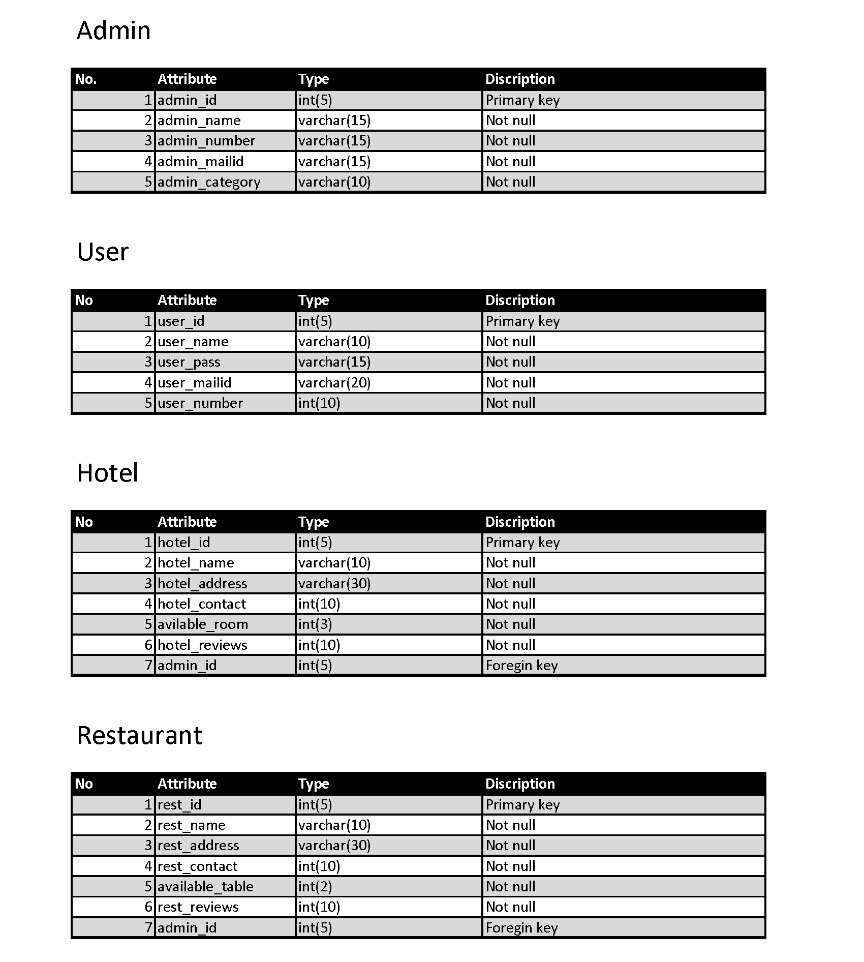
Data Dictionary

Slide 18
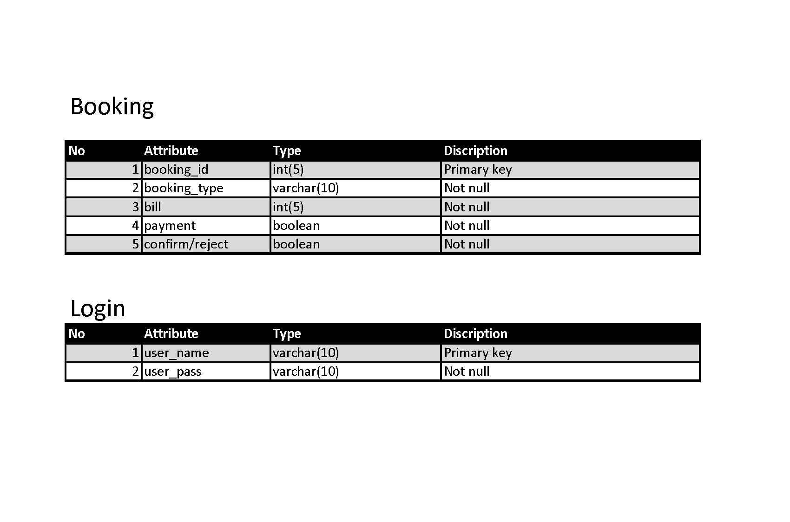
Data Dictionary

Slide 19
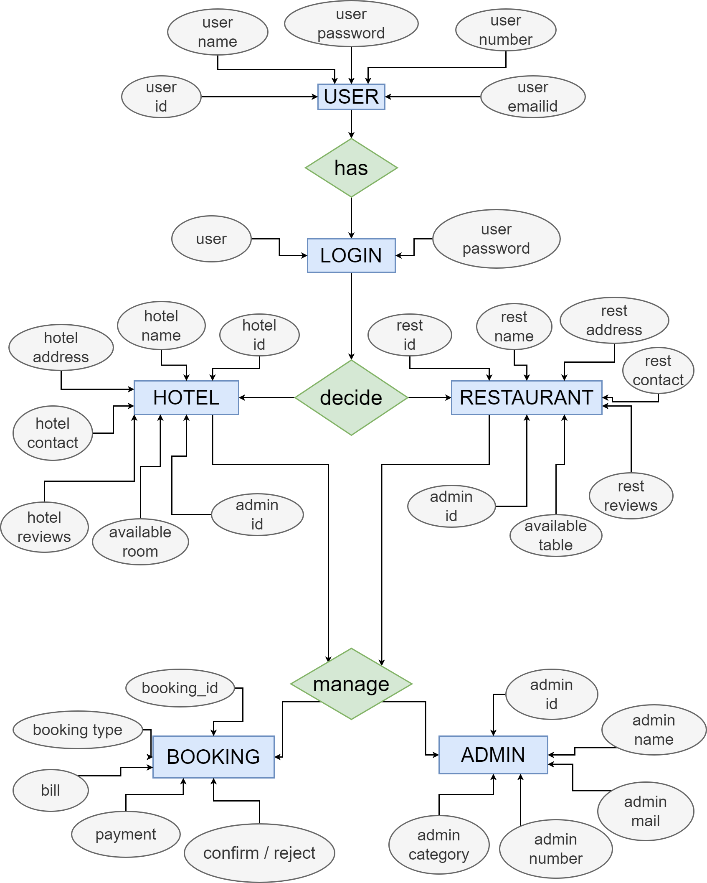
ER Diagram

Slide 20
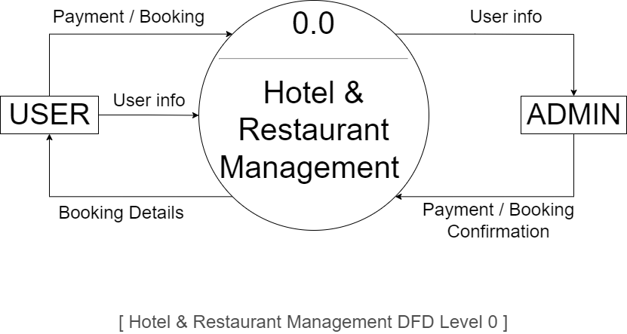
Data Flow Diagram Level - 0

Slide 21
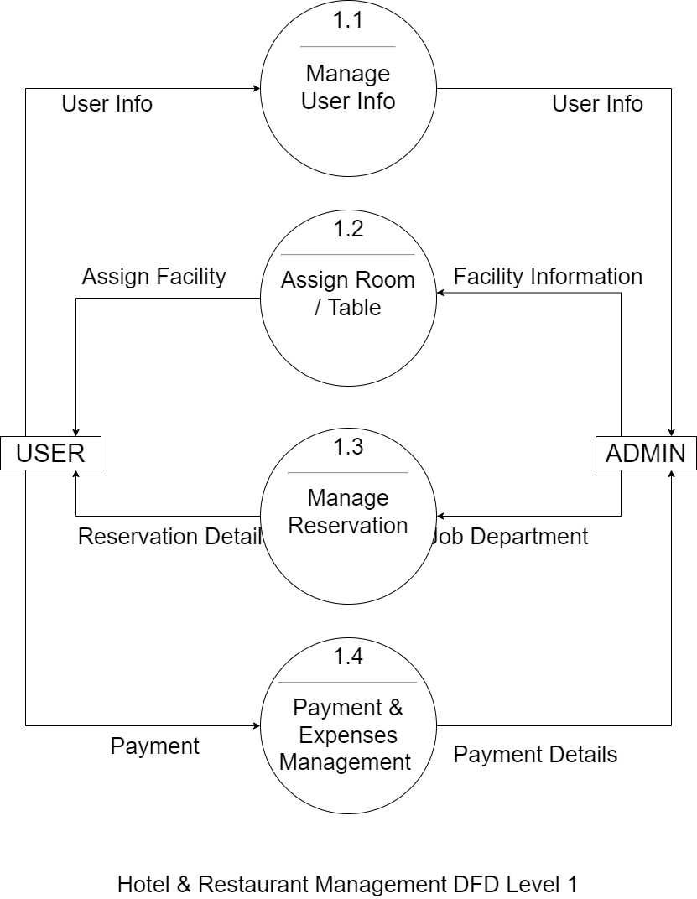
Data Flow Diagram Level - 1

Slide 22
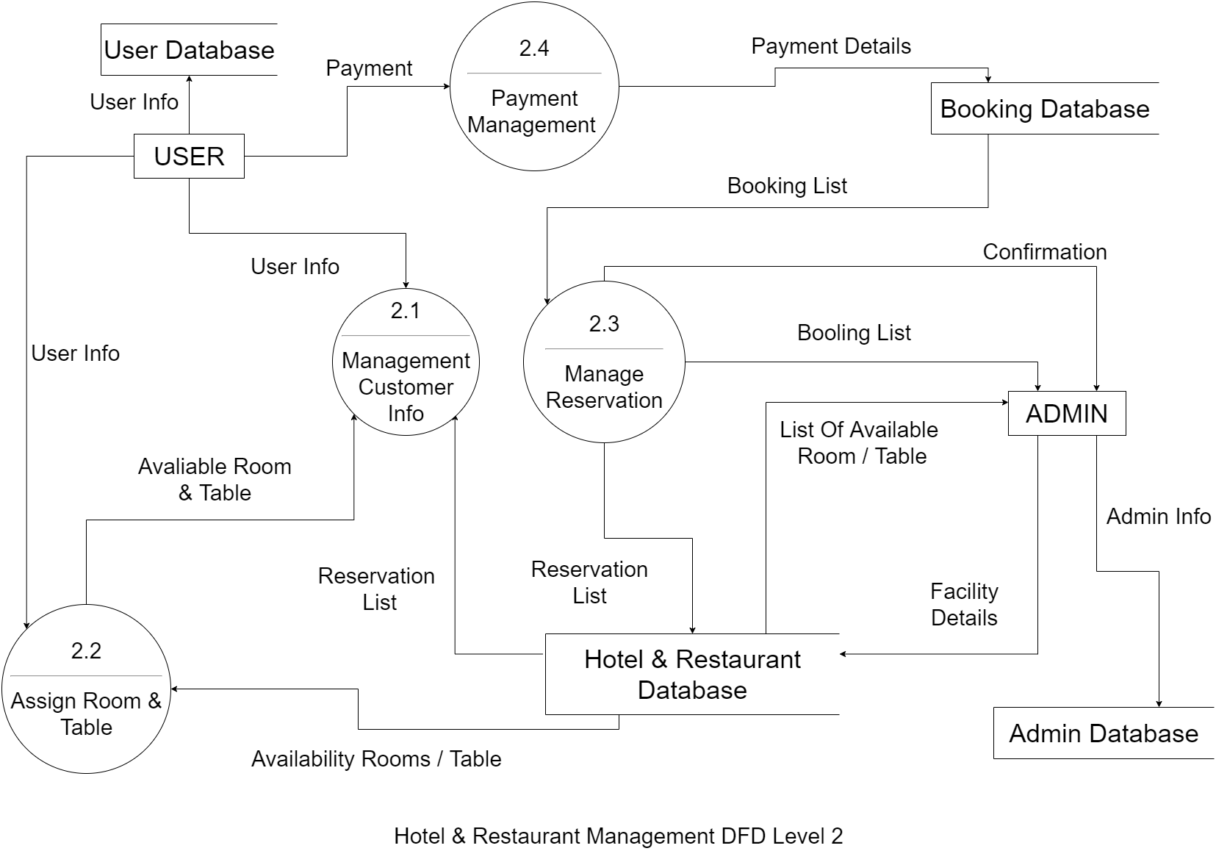
Data Flow Diagram Level - 2

Slide 23
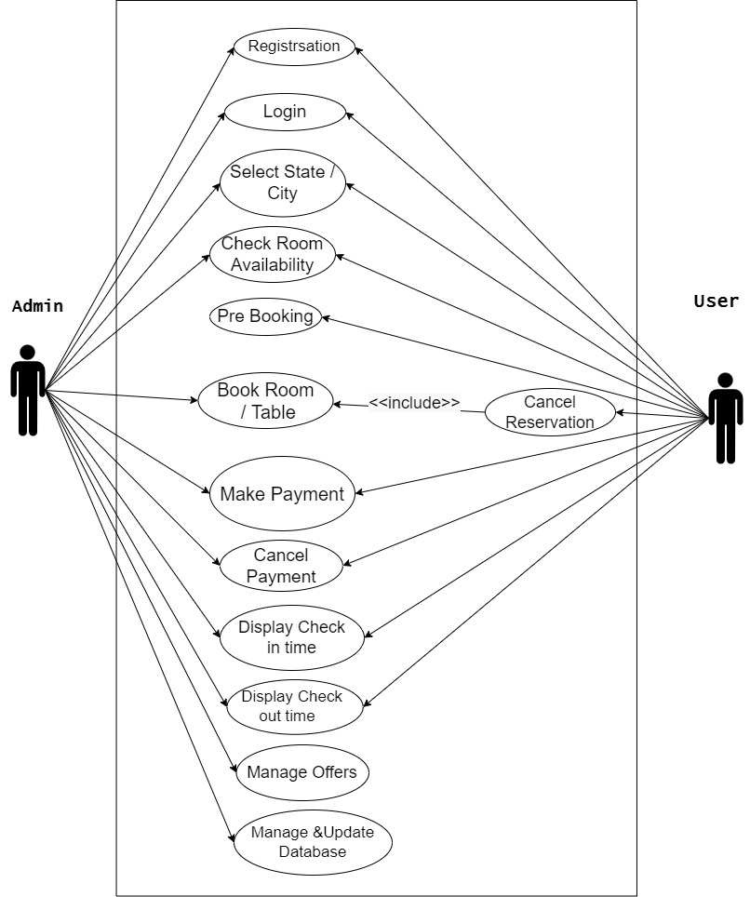
Use Case Diagram

Slide 24
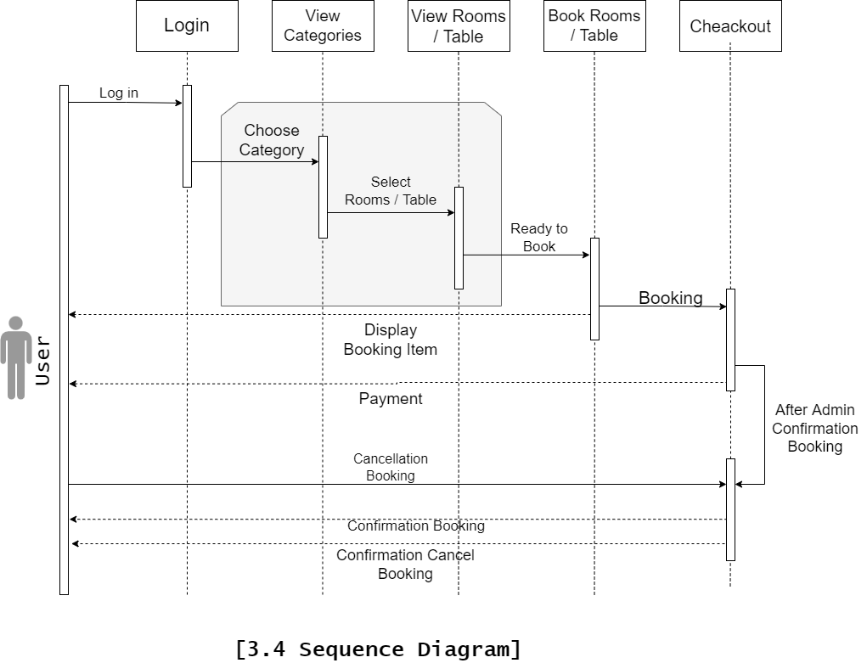
Sequence Diagram

Slide 25
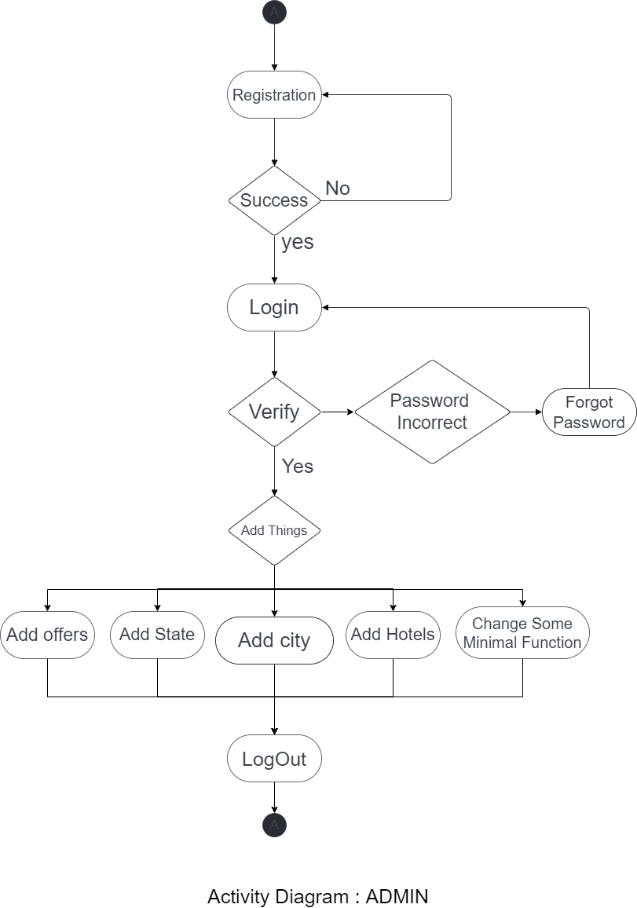
Activity Diagram

Slide 26
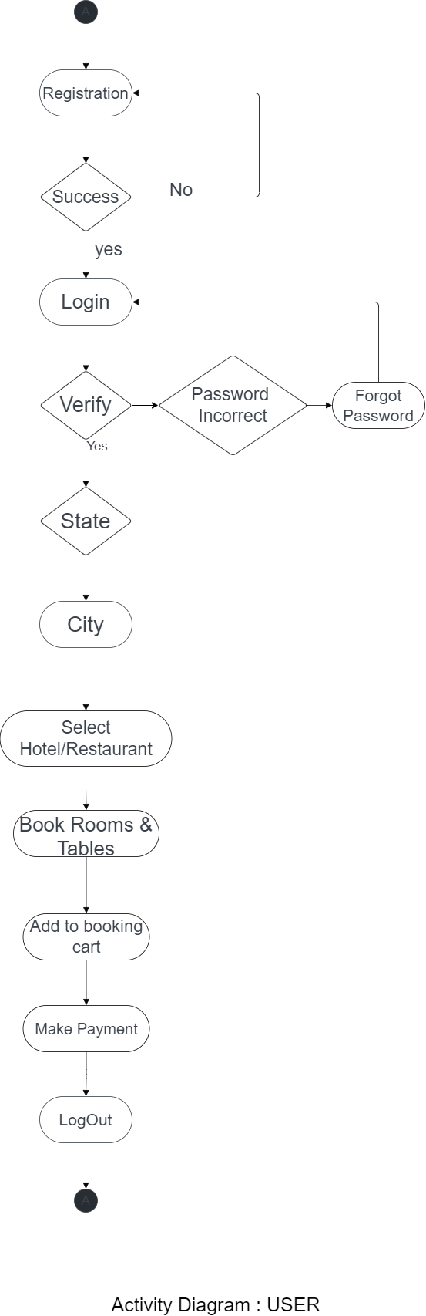
Activity Diagram

Slide 27
Implementation
This project is designed to meet the requirements of Online Hotel & Restaurant Management. It has been developed in NodeJS & MySQL keeping in mind the specifications of the system.
We will optimize the web-site more and more as time passes so its performance is best.
Security updates will be given for some time.
Optimize the code of web application will be increase for increase the performance.
We will optimize images, videos, icons, etc. for more performance

Slide 28
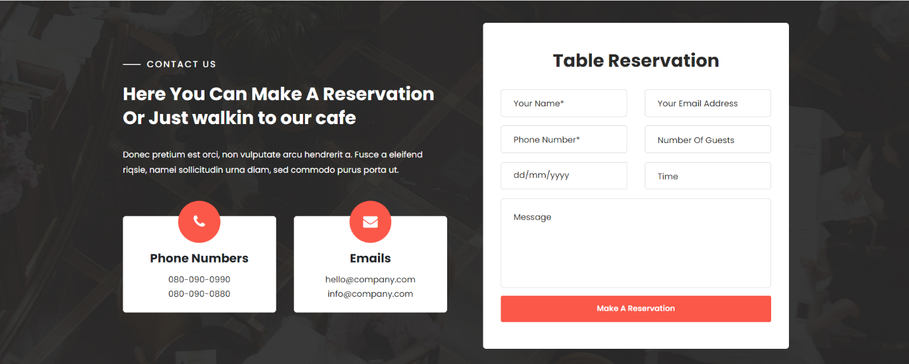
Snapshot

Slide 29
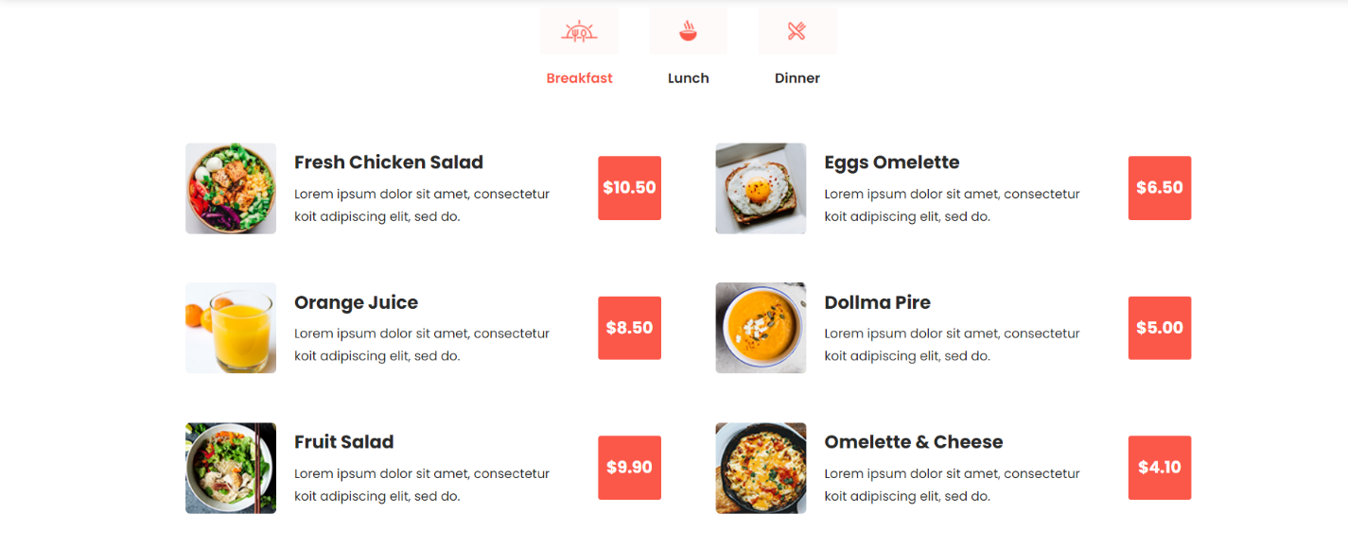
Snapshot

Slide 30
Conclusion
HOTEL & RESTAURANT MANAGENMENT SYSTEM is a Web-portal Development Company specializing in providing custom solutions for small businesses. We strive to build solutions to your specific needs to get the job done right the first time. We pay special attention to the ease of use and utilize the latest in technology.
This system is developed for the exclusively for the people . It provides facilities to the user with user friendly modules with sub modules. This system is developed in understandable approach which can be easier to the layman of the computers. This system is developed totally GUI based and with smart links.

Slide 31
References
https://www.w3schools.com/tags/default.asp (HTML)
https://www.w3schools.com/cssref/default.asp (CSS)
https://www.w3schools.com/jsref/default.asp (JS)
https://www.w3schools.com/sql/sql_ref_keywords.asp (SQL)
Node.JS Web Development : David Herron
Murach’s MySQL 3rd Edition : Murach

